Slide 1
12
Object-Oriented
Programming:
Inheritance

Slide 2
Say not you know another entirely, till you have divided an inheritance with him.
  Johann Kasper Lavater
This method is to define as the number of a class the class of all classes similar to the given class.
  Bertrand Russell
Good as it is to inherit a library, it is better to collect one.
  Augustine Birrell
Save base authority from others’ books.
  William Shakespeare

Slide 3
OBJECTIVES
In this chapter you’ll learn:
To create classes by inheriting from existing classes.
How inheritance promotes software reuse.
The notions of base classes and derived classes and the relationships between them.
The protected member access specifier.
The use of constructors and destructors in inheritance hierarchies.
The differences between public, protected and private inheritance.
The use of inheritance to customize existing software.

Slide 4
12.1 Introduction
12.2 Base Classes and Derived Classes
12.3 protected Members
12.4 Relationship between Base Classes and Derived Classes
12.4.1 Creating and Using a CommissionEmployee Class
12.4.2 Creating a BasePlusCommissionEmployee Class Without Using Inheritance
12.4.3 Creating a CommissionEmployee-BasePlusCommissionEmployee Inheritance Hierarchy
12.4.4 CommissionEmployee-BasePlusCommissionEmployee Inheritance Hierarchy Using protected Data
12.4.5 CommissionEmployee-BasePlusCommissionEmployee Inheritance Hierarchy Using private Data
12.5 Constructors and Destructors in Derived Classes
12.6 public, protected and private Inheritance
12.7 Software Engineering with Inheritance
12.8 Wrap-Up

Slide 5
12.1 Introduction
Inheritance
  Software reusability
  Create new class from existing class
    Absorb existing class’s data and behaviors
    Enhance with new capabilities
  Derived class inherits from base class
    Derived class
      More specialized group of objects
      Behaviors inherited from base class
        Can customize
      Additional behaviors

Slide 6
12.1 Introduction (Cont.)
Class hierarchy
  Direct base class
    Inherited explicitly (one level up hierarchy)
  Indirect base class
    Inherited two or more levels up hierarchy
  Single inheritance
    Inherits from one base class
  Multiple inheritance
    Inherits from multiple base classes
      Base classes possibly unrelated
    More details in chapter 24

Slide 7
12.1 Introduction (Cont.)
Three types of inheritance
  public
    Every object of derived class is also an object of base class
      Base-class objects are not objects of derived classes
      Example: All cars are vehicles, but not all vehicles are cars
    Can access non-private members of base class
      To access private base-class members
        Derived class must use inherited non-private member functions
  private
    Alternative to composition
    Chapter 21
  protected
    Rarely used

Slide 8
12.1 Introduction (Cont.)
Abstraction
  Focus on commonalities among objects in system
“is-a” vs. “has-a”
  “is-a”
    Inheritance
    Derived class object can be treated as base class object
    Example: Car is a vehicle
      Vehicle properties/behaviors also apply to a car
  “has-a”
    Composition
    Object contains one or more objects of other classes as members
    Example: Car has a steering wheel

Slide 9
Software Engineering Observation 12.1
Member functions of a derived class cannot directly access private members of the base class.

Slide 10
Software Engineering Observation 12.2
If a derived class could access its base class’s private members, classes that inherit from that derived class could access that data as well. This would propagate access to what should be private data, and the benefits of information hiding would be lost.

Slide 11
12.2 Base Classes and Derived Classes
Base classes and derived classes
  Object of one class “is an” object of another class
    Example: Rectangle is quadrilateral
      Class Rectangle inherits from class Quadrilateral
        Quadrilateral is the base class
        Rectangle is the derived class
  Base class typically represents larger set of objects than derived classes
    Example:
      Base class: Vehicle
        Includes cars, trucks, boats, bicycles, etc.
      Derived class: Car
        Smaller, more-specific subset of vehicles

Slide 12
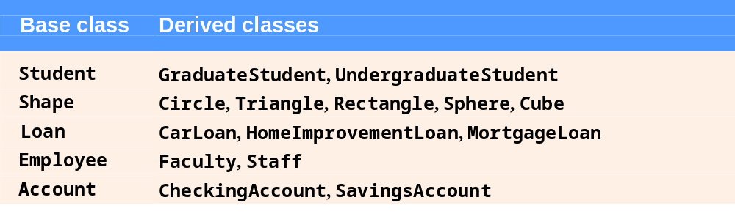
Fig. 12.1 | Inheritance examples.

Slide 13
12.2 Base Classes and Derived Classes (Cont.)
Inheritance hierarchy
  Inheritance relationships: tree-like hierarchy structure
  Each class becomes
    Base class
      Supplies data/behaviors to other classes
    OR
    Derived class
      Inherits data/behaviors from other classes

Slide 14
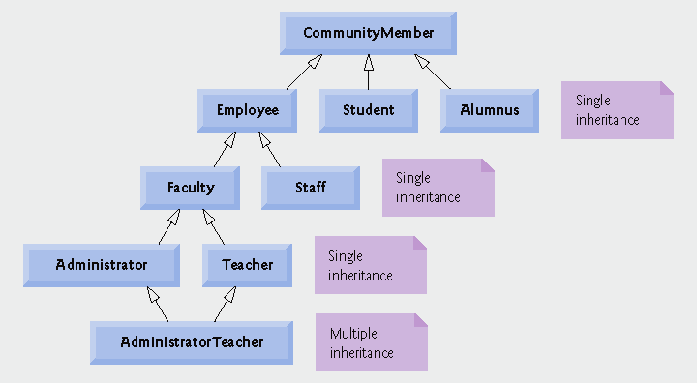
Fig. 12.2 | Inheritance hierarchy for university CommunityMembers.

Slide 15
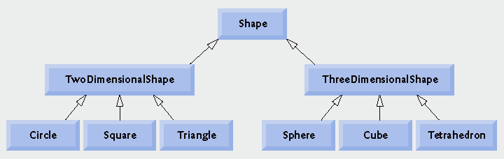
Fig. 12.3 | Inheritance hierarchy for Shapes.

Slide 16
12.2 Base Classes and Derived Classes (Cont.)
public inheritance
  Specify with:
  Class TwoDimensionalShape : public Shape
    Class TwoDimensionalShape inherits from class Shape
  Base class private members
    Not accessible directly
    Still inherited
      Manipulated through inherited public member functions
  Base class public and protected members
    Inherited with original member access
  friend functions
    Not inherited

Slide 17
12.3 protected Members
protected access
  Intermediate level of protection between public and private
  protected members are accessible to
    Base class members
    Base class friends
    Derived class members
    Derived class friends
Derived-class members
  Refer to public and protected members of base class
    Simply use member names
  Redefined base class members can be accessed by using base-class name and binary scope resolution operator (::)

Slide 18
12.4 Relationship between Base Classes and Derived Classes
Base class and derived class relationship
  Example: CommissionEmployee/BasePlusCommissionEmployee inheritance hierarchy
    CommissionEmployee
      First name, last name, SSN, commission rate, gross sale amount
    BasePlusCommissionEmployee
      First name, last name, SSN, commission rate, gross sale amount
      And also: base salary

Slide 19
12.4.1 Creating and Using a CommissionEmployee Class
Class CommissionEmployee
  CommissionEmployee header file
    Fig. 12.4
    Specify public services
      Constructor
      get and set functions
      Member functions earnings and print
  CommissionEmployee source code file
    Fig. 12.5
    Specify member-function definitions

Slide 20
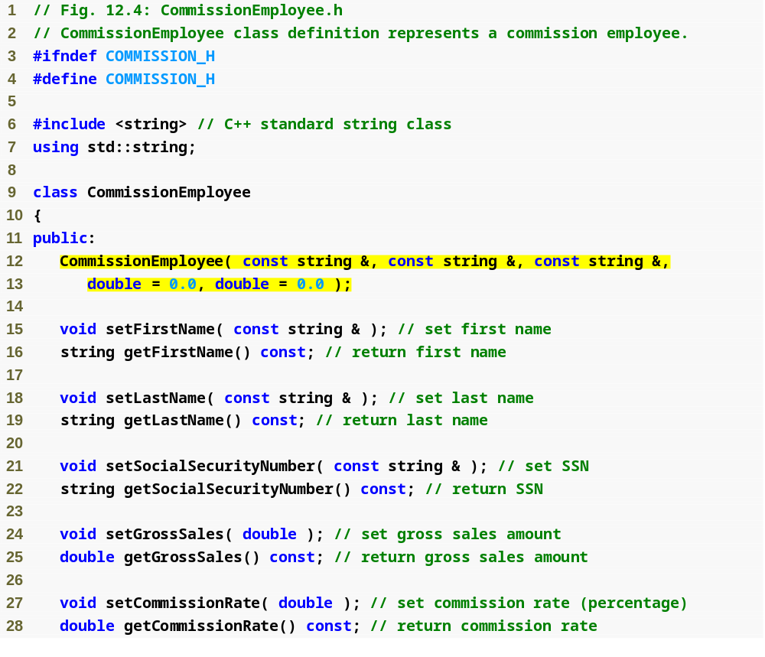
Outline
Commission
Employee.h
(1 of 2)
Class CommissionEmployee constructor

Slide 21
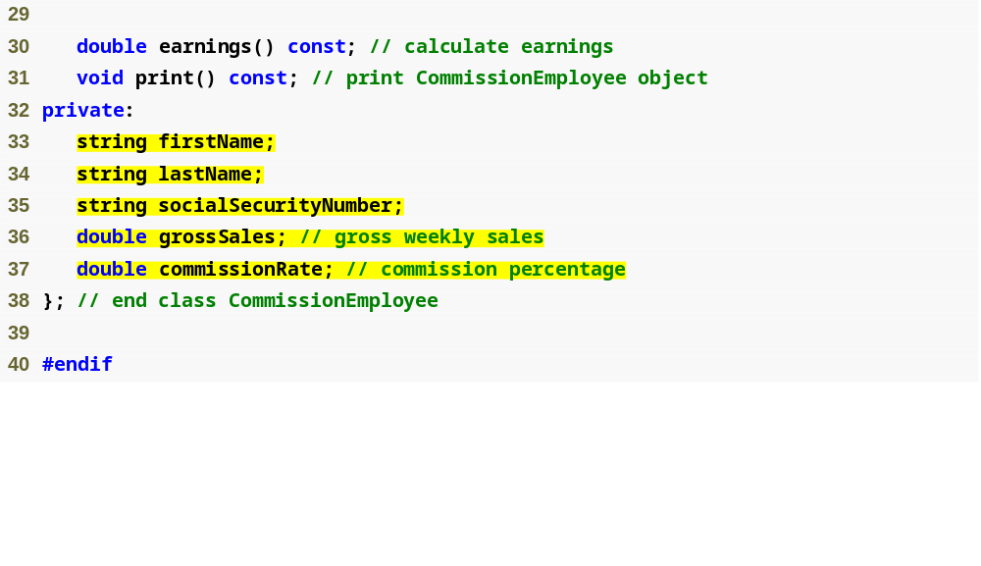
Outline
Declare private data members
Commission
Employee.h
(2 of 2)

Slide 22
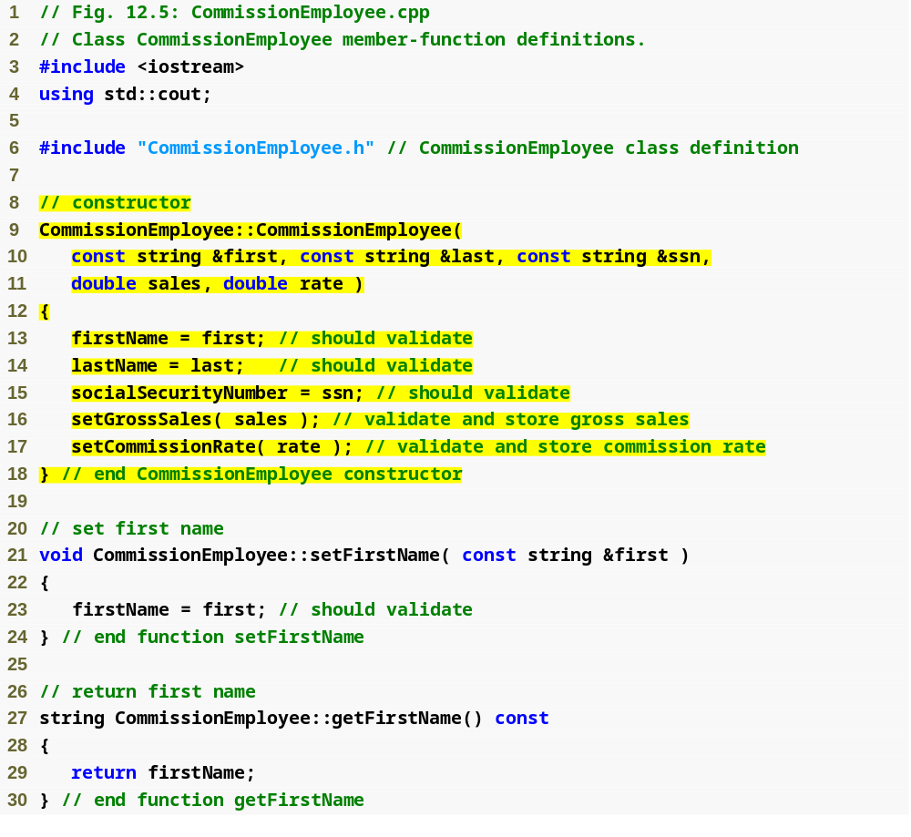
Outline
Commission
Employee.cpp
(1 of 4)
Initialize data members

Slide 23
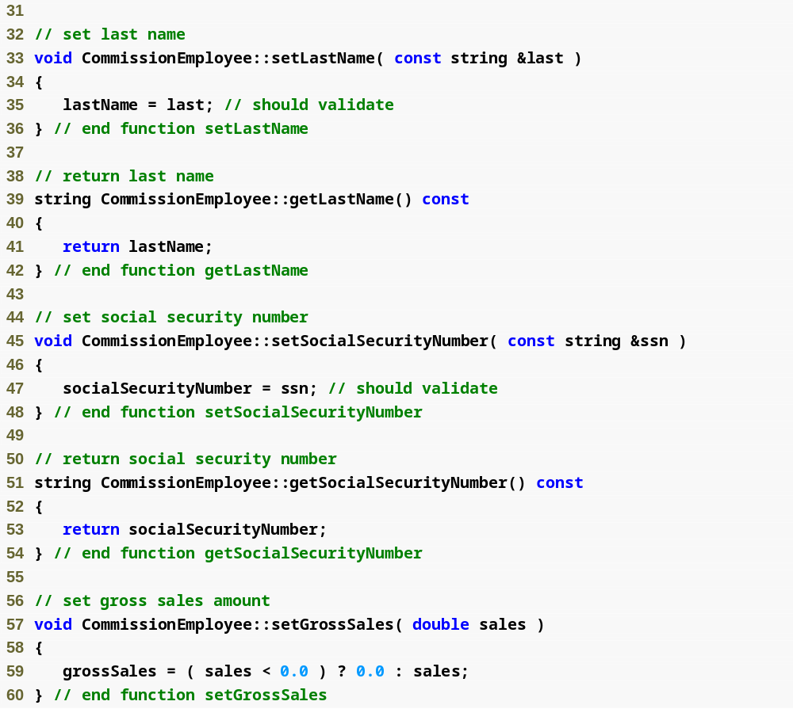
Outline
Commission
Employee.cpp
(2 of 4)
Function setGrossSales validates gross sales amount

Slide 24
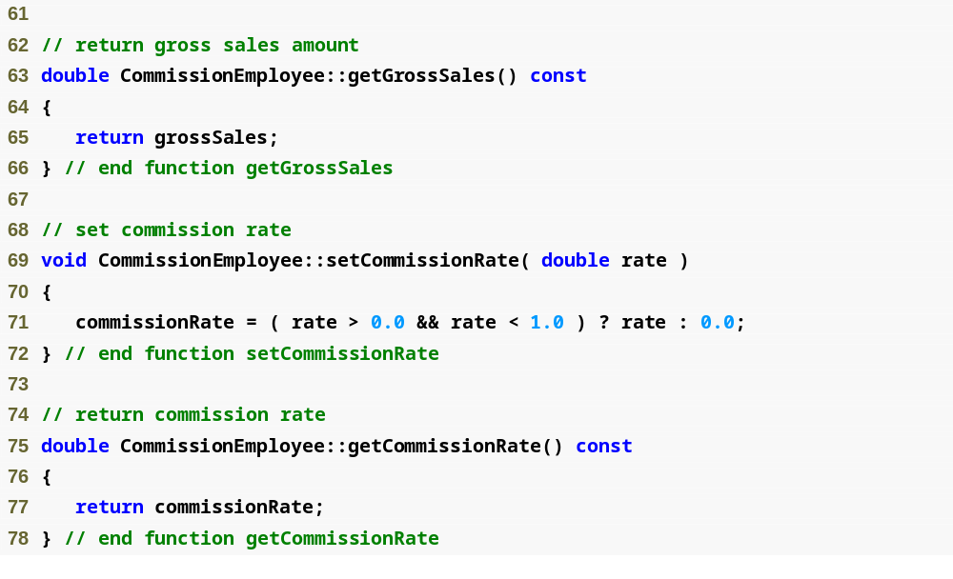
Outline
Function setCommissionRate validates commission rate
Commission
Employee.cpp
(3 of 4)

Slide 25
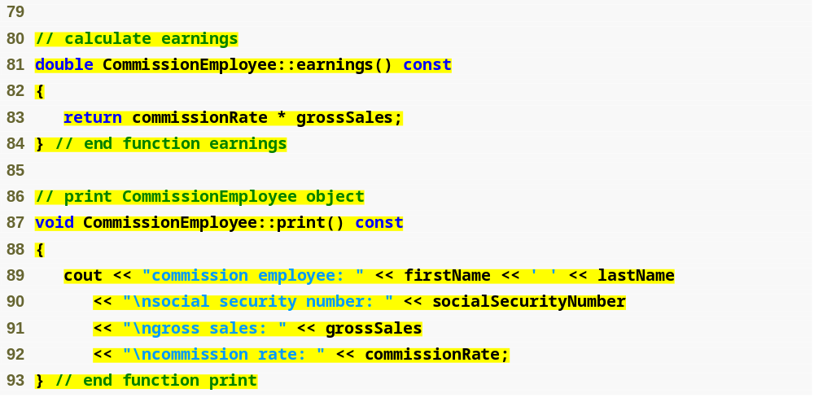
Outline
Function earnings calculates earnings
Commission
Employee.cpp
(4 of 4)
Function print displays CommissionEmployee object

Slide 26
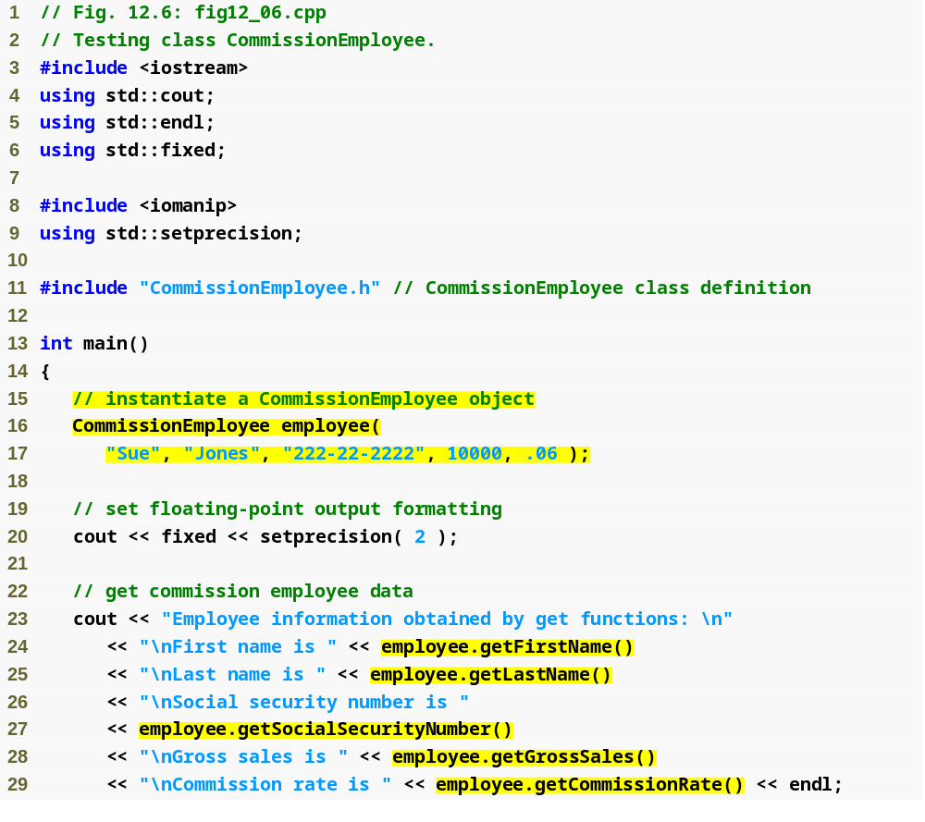
Outline
fig12_06.cpp
(1 of 2)
Instantiate CommissionEmployee object
Use CommissionEmployee’s get functions to retrieve the object’s instance variable values

Slide 27
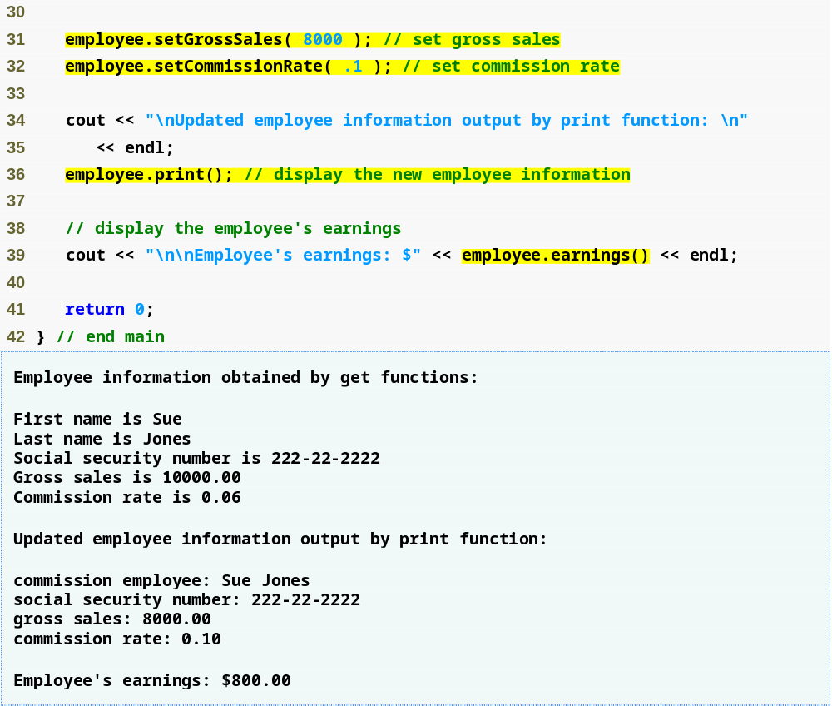
Outline
Use CommissionEmployee’s set functions to change the object’s instance variable values
fig12_06.cpp
(2 of 2)
Call object’s print function to display employee information
Call object’s earnings function to calculate earnings

Slide 28
12.4.2 Creating a BasePlusCommissionEmployee Class Without Using Inheritance
Class BasePlusCommissionEmployee
  Much of the code is similar to CommissionEmployee
    private data members
    public methods
    constructor
  Additions
    private data member baseSalary
    Methods setBaseSalary and getBaseSalary

Slide 29
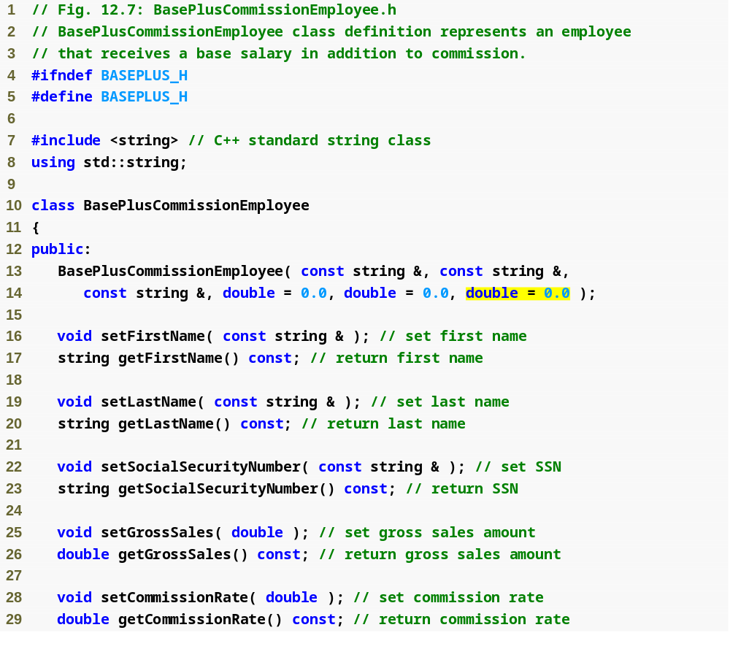
Outline
BasePlus
Commission
Employee.h
(1 of 2)
Constructor takes one more argument, which specifies the base salary

Slide 30
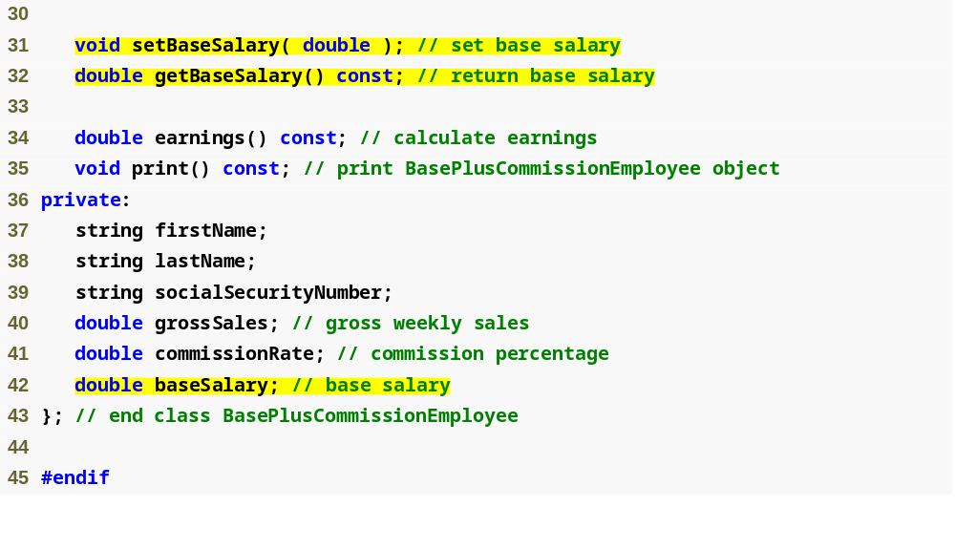
Define get and set functions for data member baseSalary
Outline
BasePlus
Commission
Employee.h
(2 of 2)
Add data member baseSalary

Slide 31
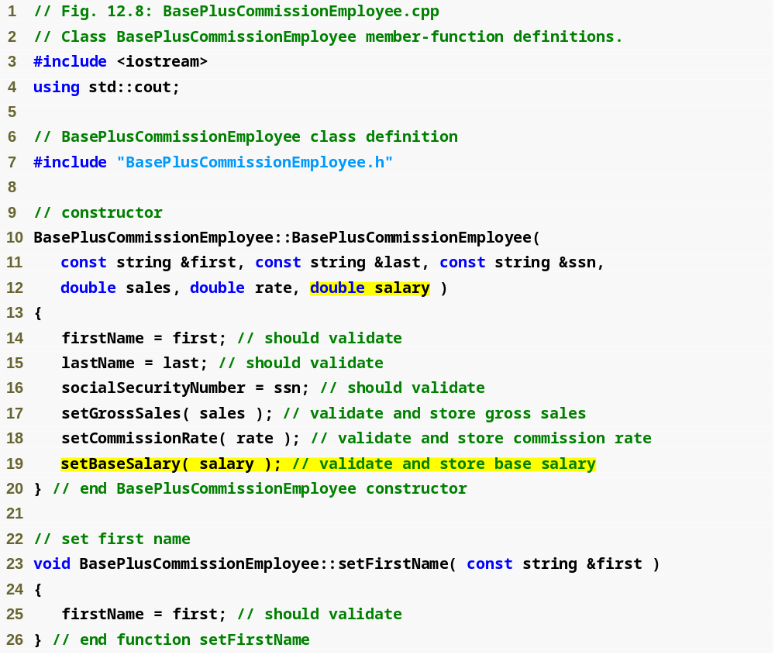
Outline
BasePlus
Commission
Employee.cpp
(1 of 4)
Constructor takes one more argument, which specifies the base salary
Use function setBaseSalary to validate data

Slide 32
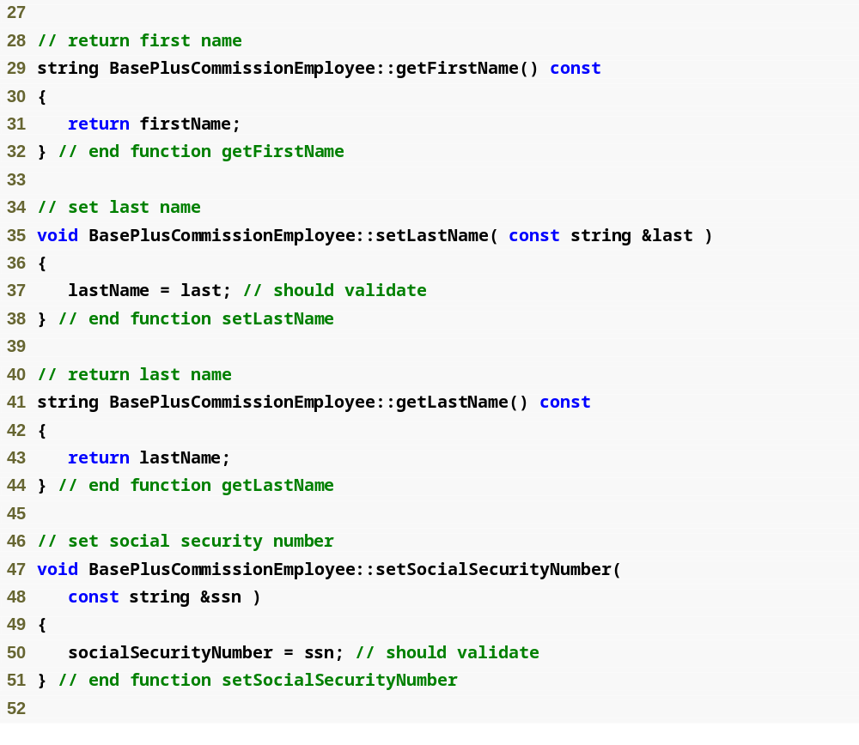
Outline
BasePlus
Commission
Employee.cpp
(2 of 4)

Slide 33
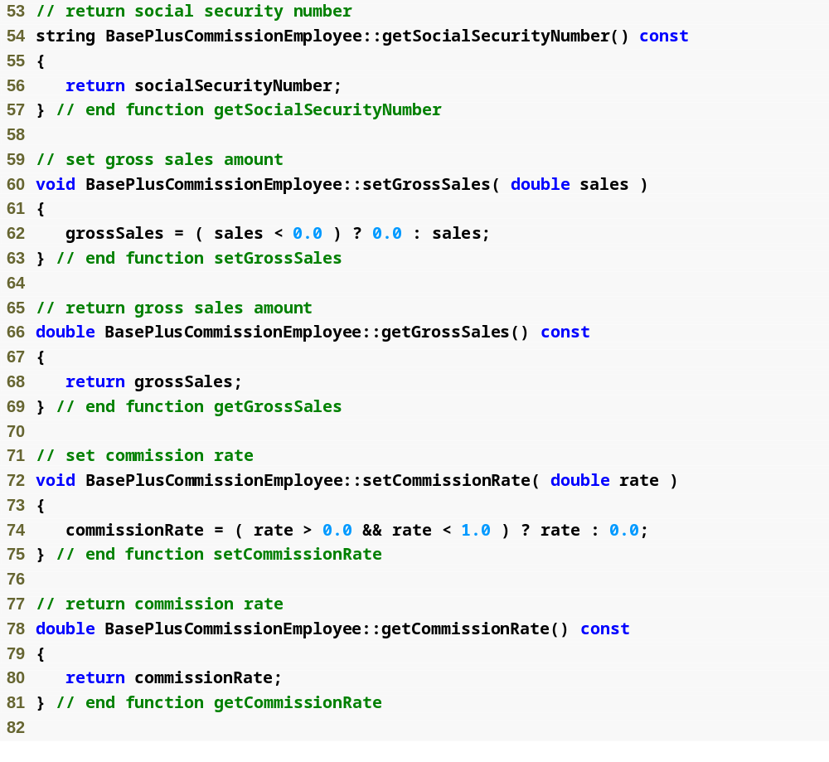
Outline
BasePlus
Commission
Employee.cpp
(3 of 4)

Slide 34
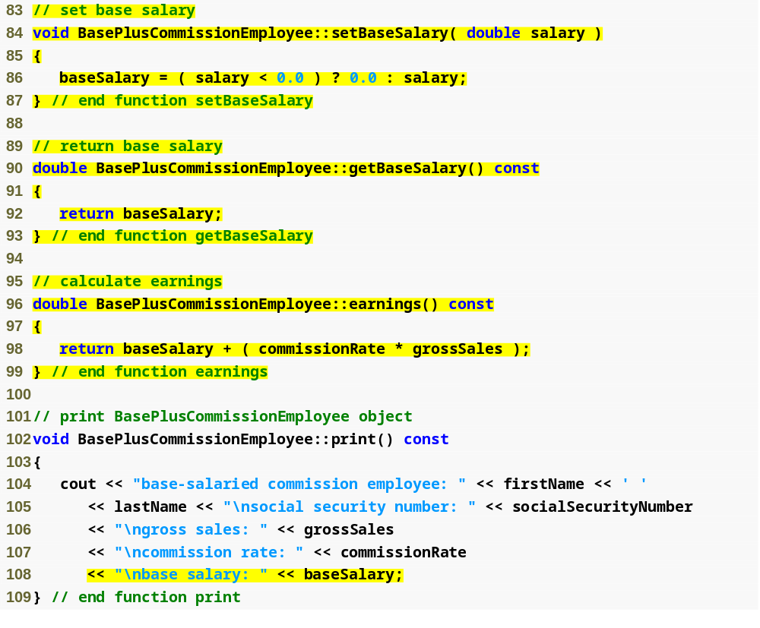
Outline
Function setBaseSalary validates data and sets instance variable baseSalary
BasePlus
Commission
Employee.cpp
(4 of 4)
Function getBaseSalary returns the value of instance variable baseSalary
Update function earnings to calculate the earnings of a base-salaried commission employee
Update function print to display base salary

Slide 35
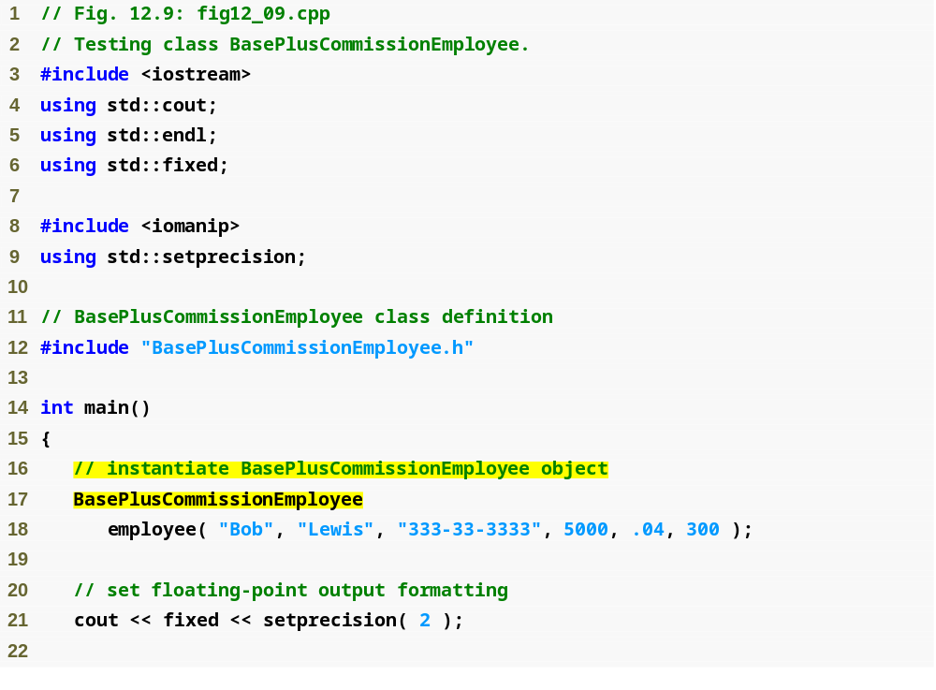
Outline
fig12_09.cpp
(1 of 3)
Instantiate BasePlusCommissionEmployee object

Slide 36
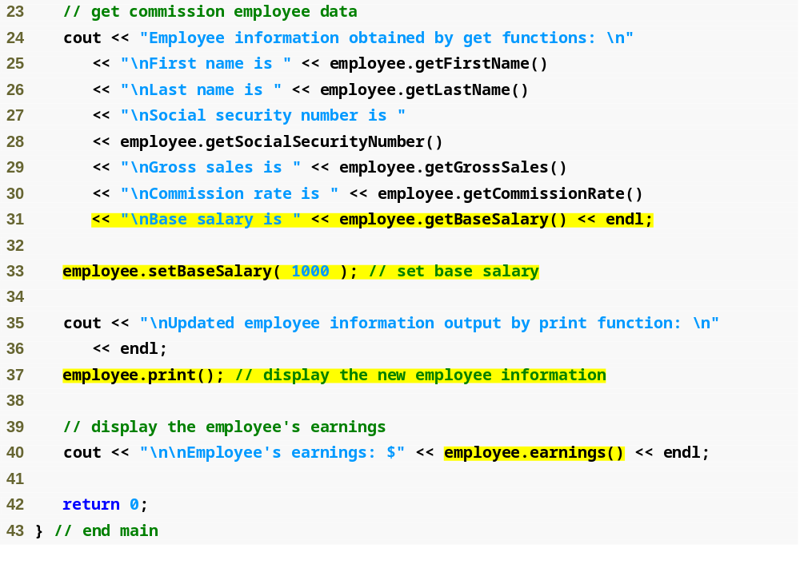
Outline
Use BasePlusCommissionEmployee’s get functions to retrieve the object’s instance variable values
fig12_09.cpp
(2 of 3)
Use BasePlusCommissionEmployee’s setBaseSalary function to set base salary
Call object’s print function to display employee information
Call object’s earnings function to calculate employee’s earnings

Slide 37
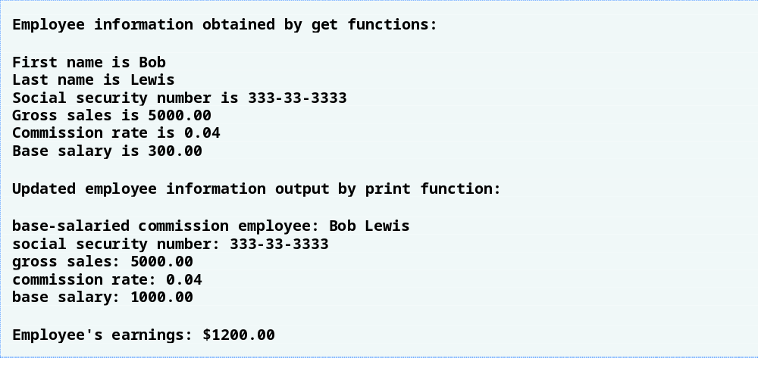
Outline
fig12_09.cpp
(3 of 3)

Slide 38
Software Engineering Observation 12.3
Copying and pasting code from one class to another can spread errors across multiple source code files. To avoid duplicating code (and possibly errors), use inheritance, rather than the “copy-and-paste” approach, in situations where you want one class to “absorb” the data members and member functions of another class.

Slide 39
Software Engineering Observation 12.4
With inheritance, the common data members and member functions of all the classes in the hierarchy are declared in a base class. When changes are required for these common features, software developers need to make the changes only in the base class—derived classes then inherit the changes. Without inheritance, changes would need to be made to all the source code files that contain a copy of the code in question.

Slide 40
12.4.3 Creating a CommissionEmployee-BasePlusCommissionEmployee Inheritance Hierarchy
Class BasePlusCommissionEmployee
  Derived from class CommissionEmployee
    Is a CommissionEmployee
    Inherits all public members
  Constructor is not inherited
    Use base-class initializer syntax to initialize base-class data member
  Has data member baseSalary

Slide 41
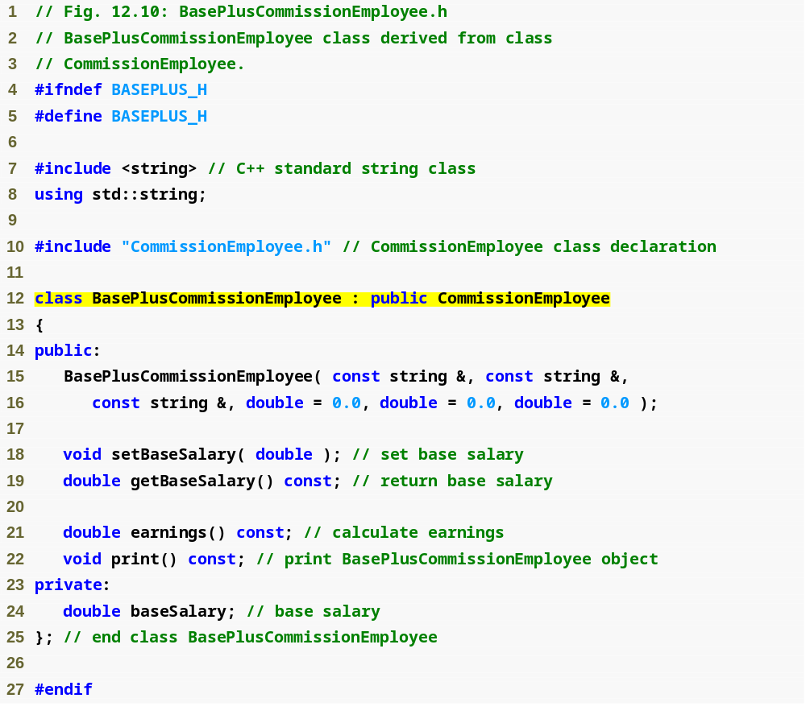
Outline
BasePlus
Commission
Employee.h
(1 of 1)
Include the base-class header file in the derived-class header file
Class BasePlusCommissionEmployee derives publicly from class CommissionEmployee

Slide 42
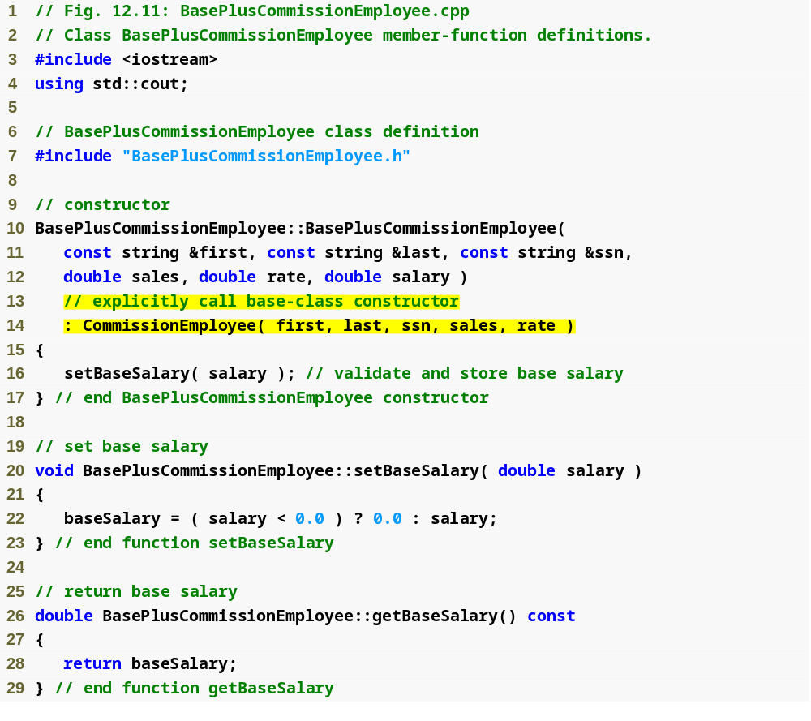
Outline
BasePlus
Commission
Employee.cpp
(1 of 4)
Initialize base class data member by calling the base-class constructor using base-class initializer syntax

Slide 43
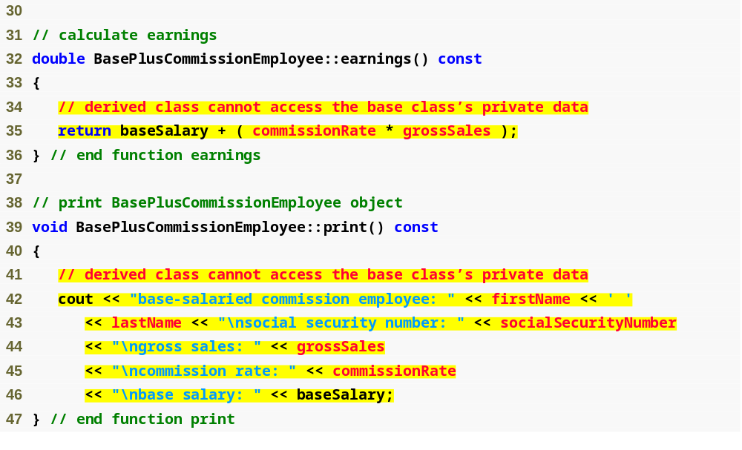
Outline
BasePlus
Commission
Employee.cpp
(2 of 4)
Compiler generates errors because base class’s data member commissionRate and grossSales are private
Compiler generates errors because the base class’s data members firstName, lastName, socialSecurityNumber, grossSales and commissionRate are private

Slide 44
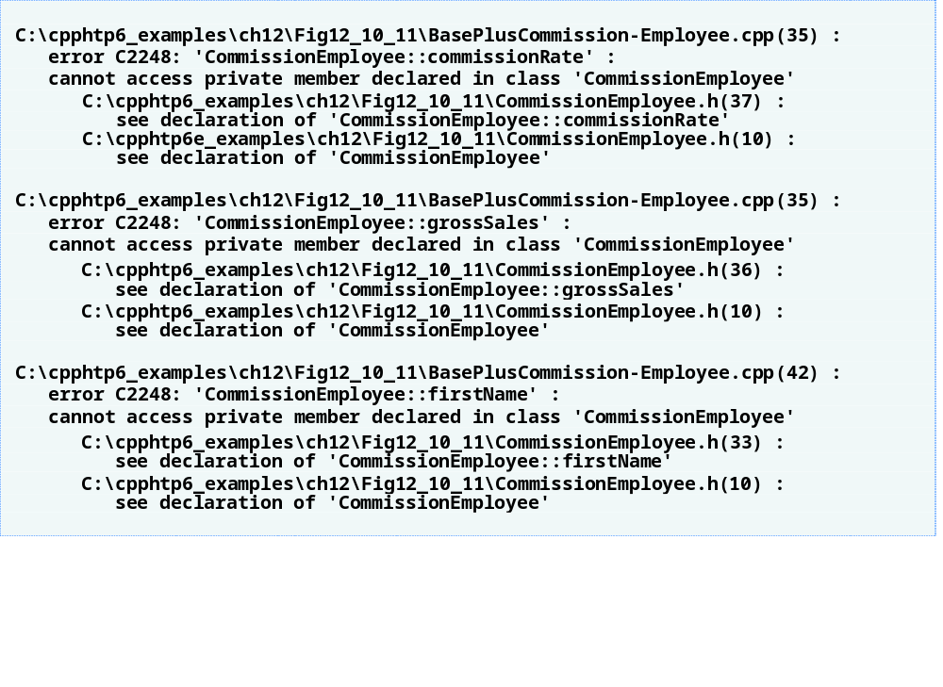
Outline
BasePlus
Commission
Employee.cpp
(3 of 4)

Slide 45
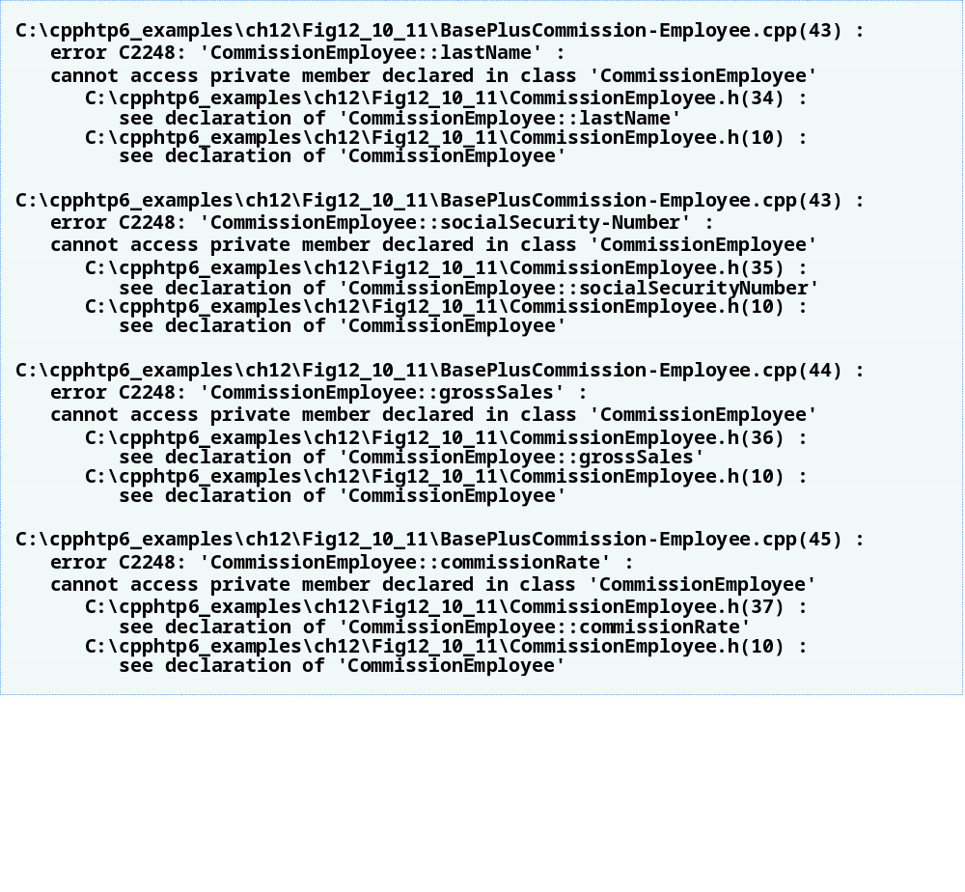
Outline
BasePlus
Commission
Employee.cpp
(4 of 4)

Slide 46
Common Programming Error 12.1
A compilation error occurs if a derived-class constructor calls one of its base-class constructors with arguments that are inconsistent with the number and types of parameters specified in one of the base-class constructor definitions.

Slide 47
Performance Tip 12.1
In a derived-class constructor, initializing member objects and invoking base-class constructors explicitly in the member initializer list prevents duplicate initialization in which a default constructor is called, then data members are modified again in the derived-class constructor’s body.

Slide 48
12.4.3 Creating a CommissionEmployee-BasePlusCommissionEmployee Inheritance Hierarchy (Cont.)
Including the base class header file
  Base class header file must be included in derived class header file for three reasons, the compiler must
    Know that base class exists
    Know size of inherited data members
    Ensure that inherited class members are used properly

Slide 49
12.4.4 CommissionEmployee-BasePlusCommissionEmployee Inheritance Hierarchy Using protected Data
Use protected data
  Enable class BasePlusCommissionEmployee to directly access base class data members
  Base class’s protected members are inherited by all derived classes of that base class

Slide 50
Good Programming Practice 12.1
Declare public members first, protected members second and private members last.

Slide 51
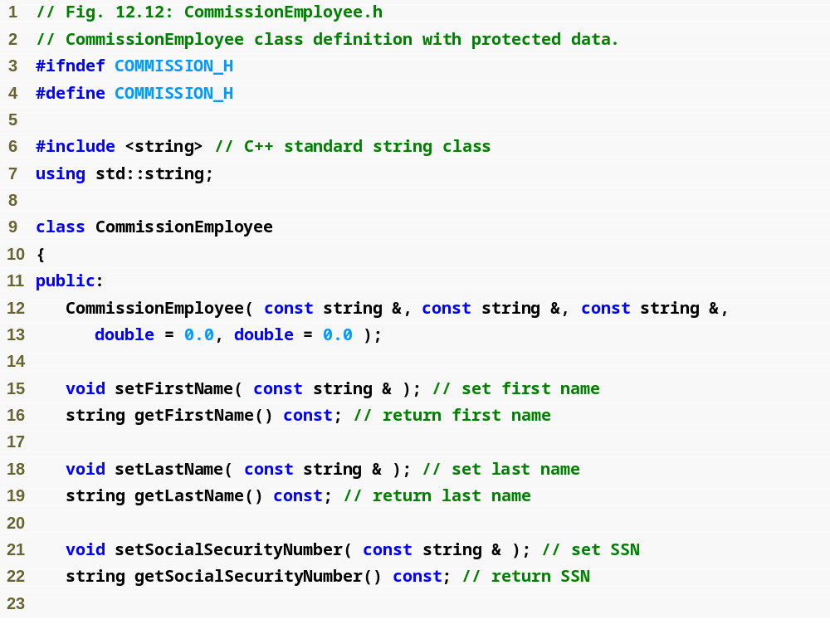
Outline
Commission
Employee.h
(1 of 2)

Slide 52
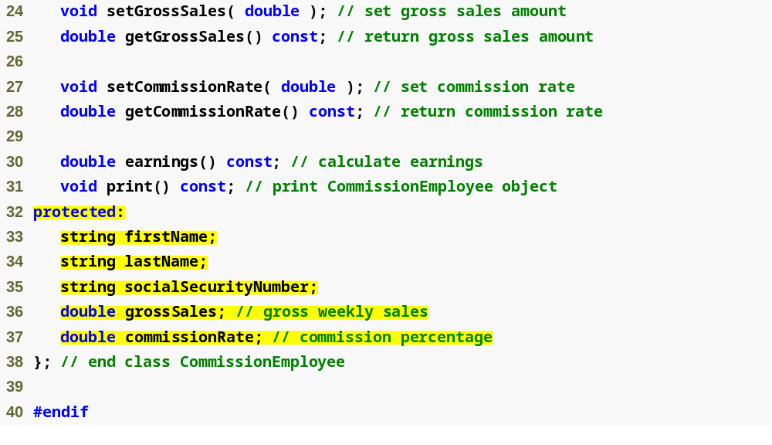
Outline
Commission
Employee.h
(2 of 2)
Declare protected data

Slide 53
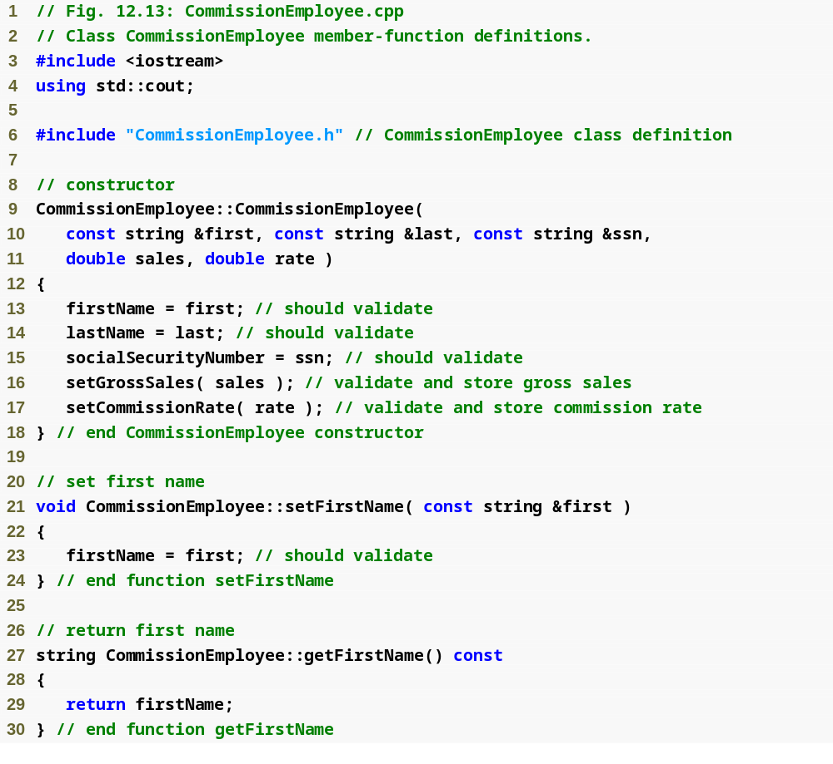
Outline
Commission
Employee.cpp
(1 of 4)

Slide 54
Outline
Commission
Employee.cpp
(2 of 4)

Slide 55
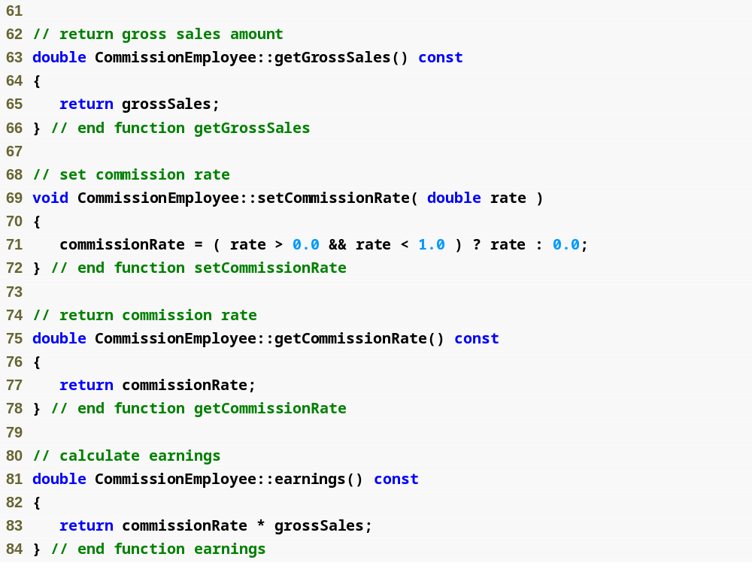
Outline
Commission
Employee.cpp
(3 of 4)

Slide 56
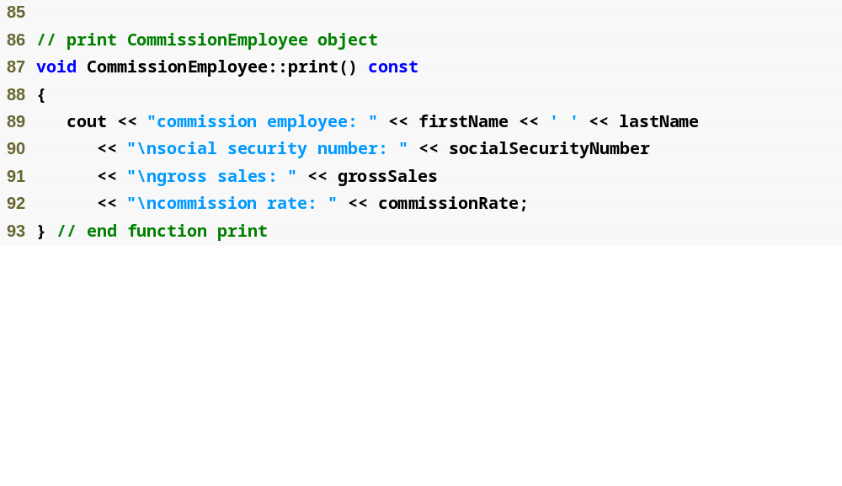
Outline
Commission
Employee.cpp
(4 of 4)

Slide 57
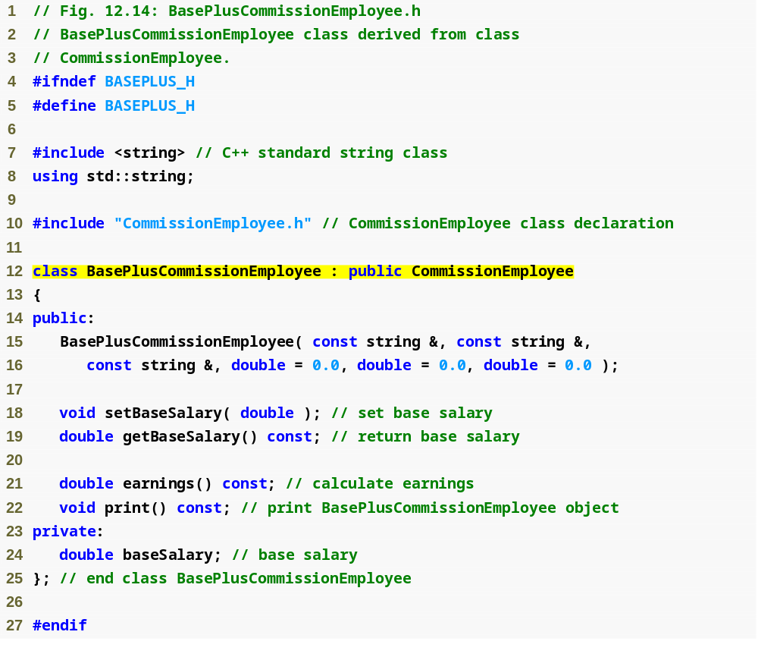
Outline
BasePlus
Commission
Employee.h
(1 of 1)
BasePlusCommissionEmployee still inherits publicly from CommissionEmployee

Slide 58

Outline
BasePlus
Commission
Employee.cpp
(1 of 2)
Call base-class constructor using base-class initializer syntax

Slide 59
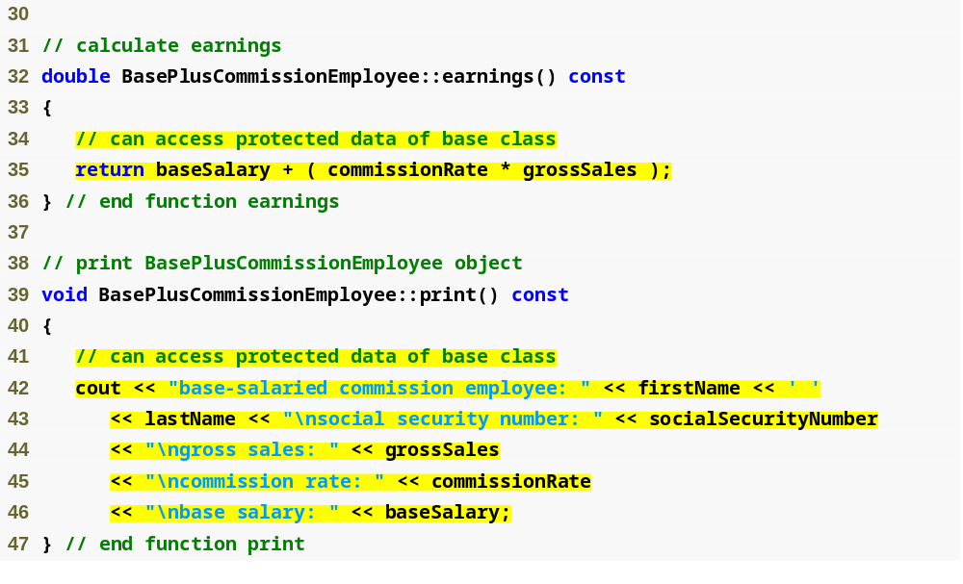
Outline
BasePlus
Commission
Employee.cpp
(2 of 2)
Directly access base class’s protected data

Slide 60

Outline
Fig12_16.cpp
(1 of 3)

Slide 61

Outline
Fig12_16.cpp
(2 of 3)

Slide 62
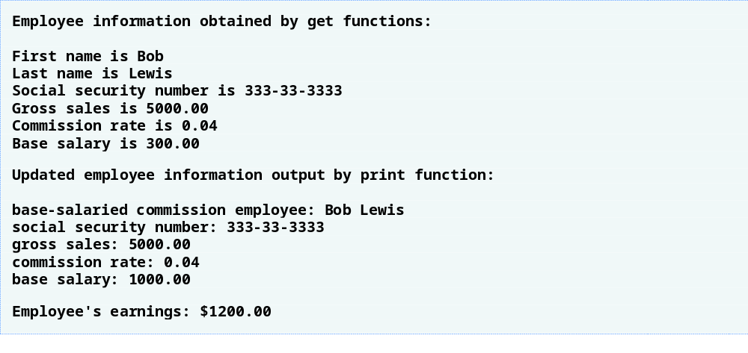
Outline
Fig12_16.cpp
(3 of 3)

Slide 63
12.4.4 CommissionEmployee-BasePlusCommissionEmployee Inheritance Hierarchy Using protected Data (Cont.)
Using protected data members
  Advantages
    Derived class can modify values directly
      Avoid set/get method call overhead
        Slight increase in performance
  Disadvantages
    No validity checking
      Derived class can assign illegal value
    Implementation dependent
      Derived class functions more likely dependent on base class implementation
      Base class implementation changes may result in derived class modifications
        Fragile (brittle) software

Slide 64
Software Engineering Observation 12.5
It is appropriate to use the protected access specifier when a base class should provide a service (i.e., a member function) only to its derived classes (and friends), not to other clients.

Slide 65
Software Engineering Observation 12.6
Declaring base-class data members private (as opposed to declaring them protected) enables programmers to change the base-class implementation without having to change derived-class implementations.

Slide 66
Error-Prevention Tip 12.1
When possible, avoid including protected data members in a base class. Rather, include non-private member functions that access private data members, ensuring that the object maintains a consistent state.

Slide 67
12.4.5 CommissionEmployee-BasePlusCommissionEmployee Inheritance Hierarchy Using private Data
Reexamine hierarchy
  Use the best software engineering practice
    Declare data members as private
    Provide public get and set functions
    Use get method to obtain values of data members

Slide 68
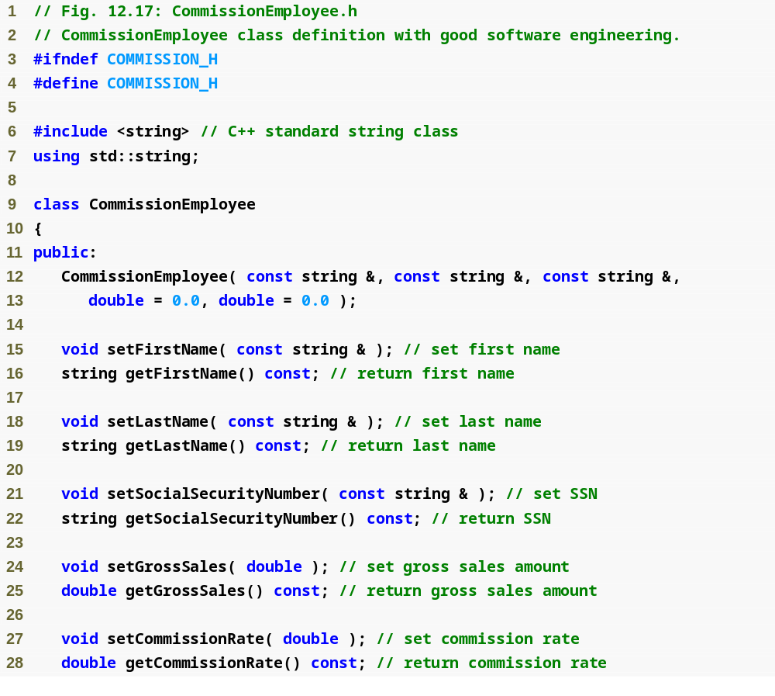
Outline
Commission
Employee.h
(1 of 2)

Slide 69
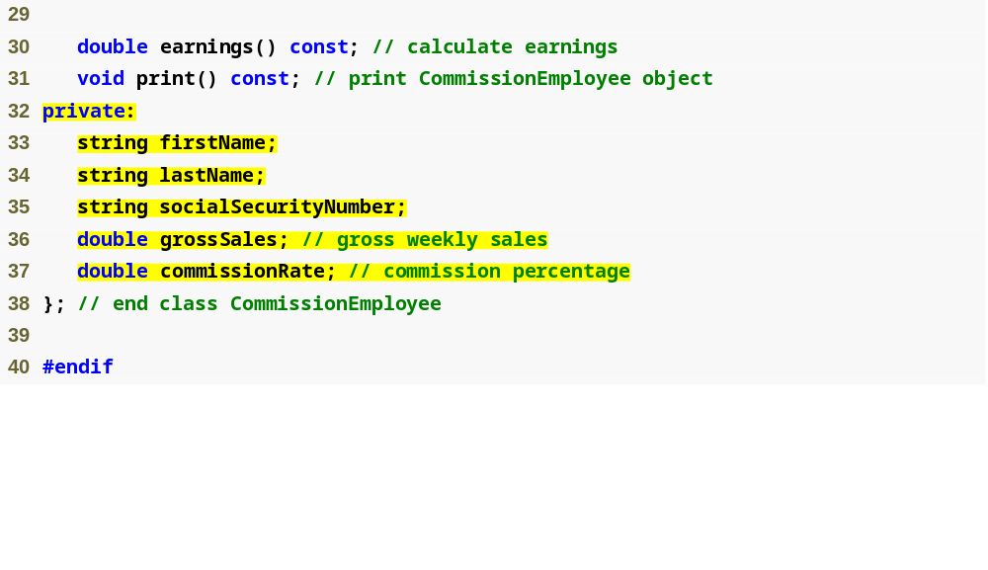
Outline
Declare private data
Commission
Employee.h
(2 of 2)

Slide 70
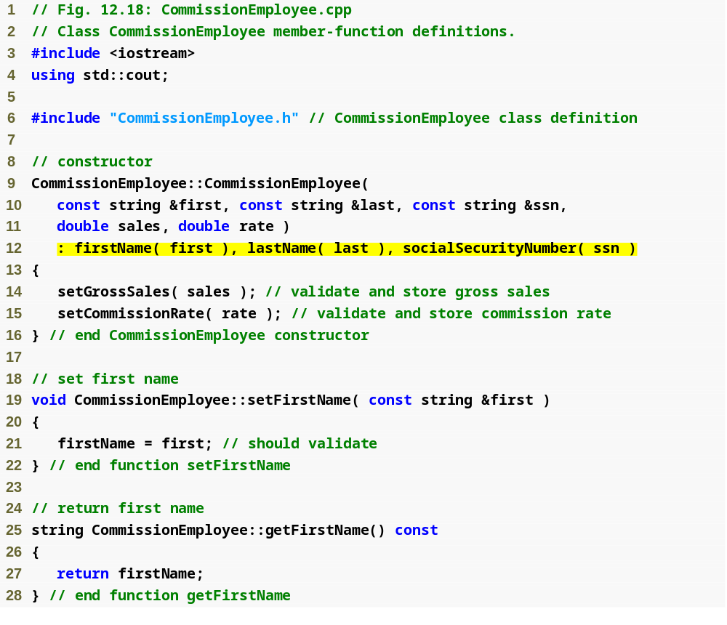
Outline
Commission
Employee.cpp
(1 of 4)
Use member initializers to set the values of members firstName, lastname and socialSecurityNumber

Slide 71
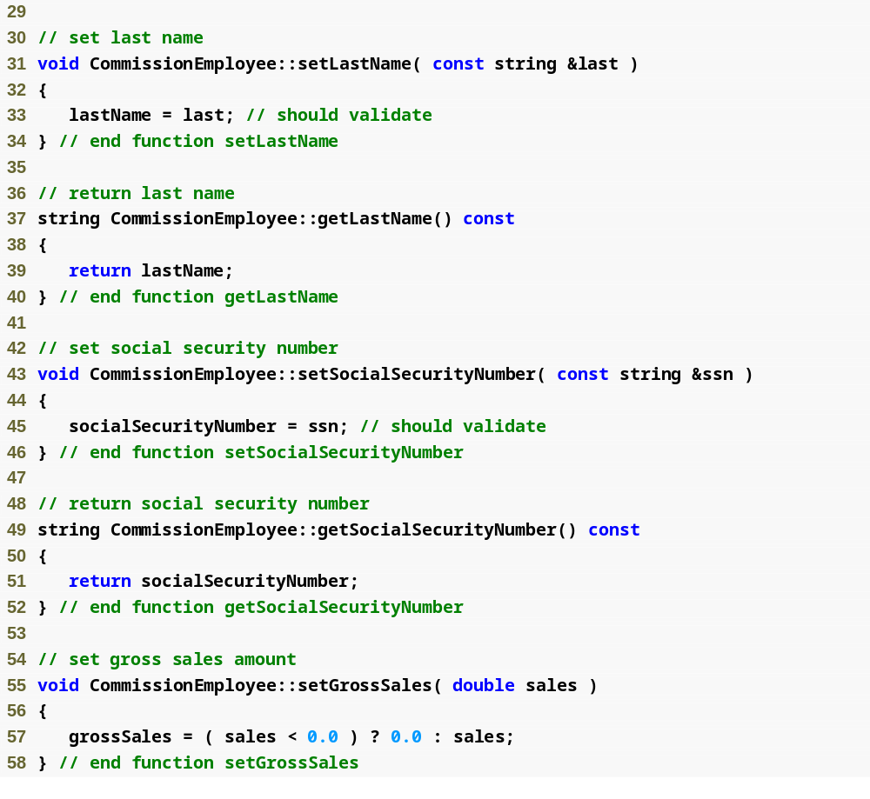
Outline
Commission
Employee.cpp
(2 of 4)

Slide 72
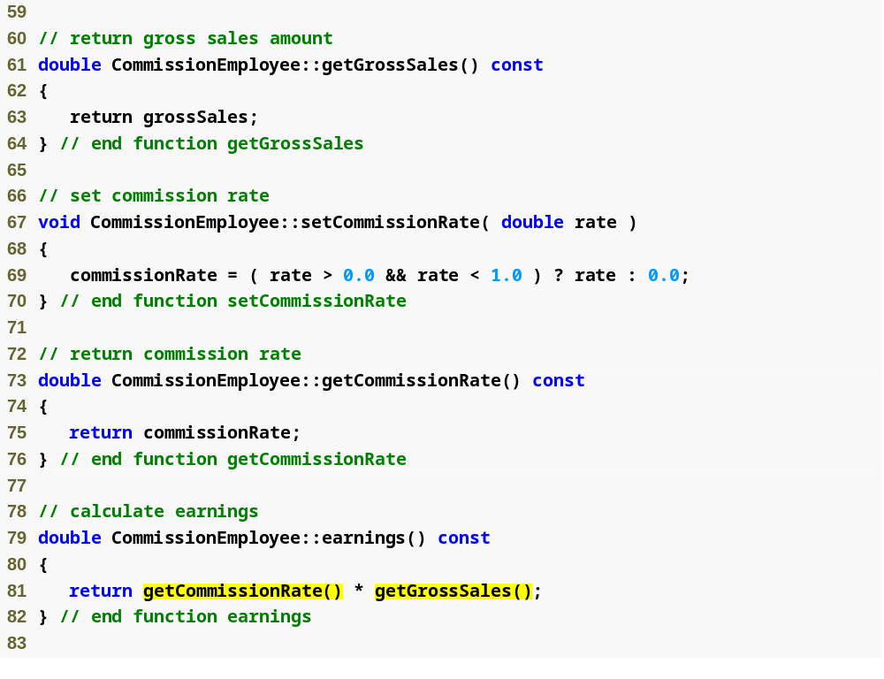
Outline
Commission
Employee.cpp
(3 of 4)
Use get functions to obtain the values of data members

Slide 73
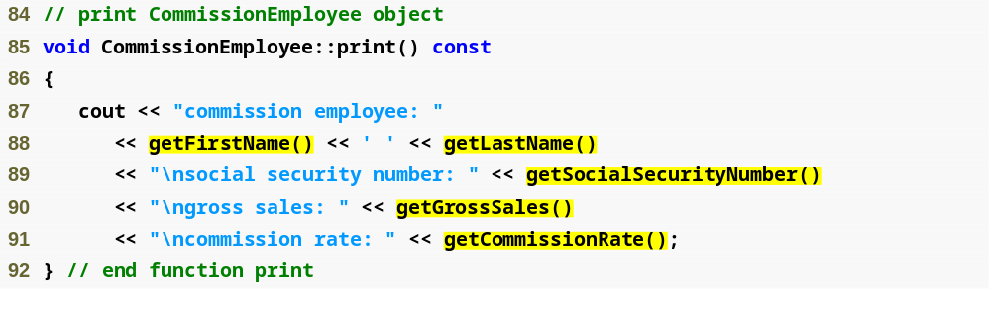
Outline
Commission
Employee.cpp
(4 of 4)
Use get functions to obtain the values of data members

Slide 74
Performance Tip 12.2
Using a member function to access a data member’s value can be slightly slower than accessing the data directly. However, today’s optimizing compilers are carefully designed to perform many optimizations implicitly (such as inlining set and get member-function calls). As a result, programmers should write code that adheres to proper software engineering principles, and leave optimization issues to the compiler. A good rule is, “Do not second-guess the compiler.”

Slide 75

Outline
BasePlus
Commission
Employee.h
(1 of 1)

Slide 76
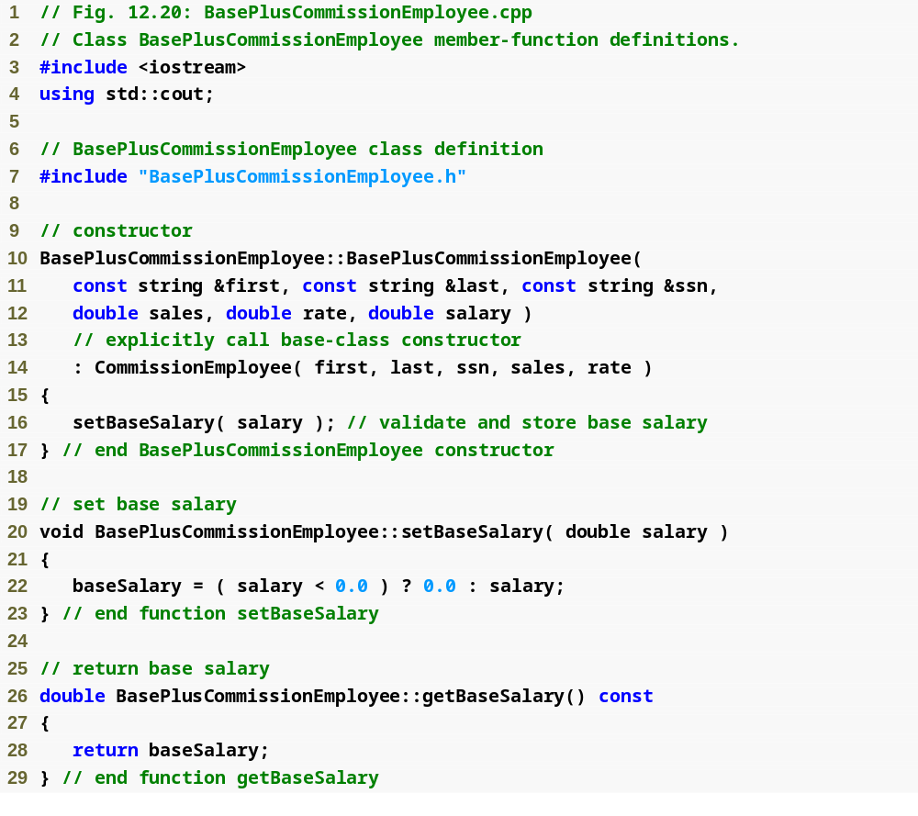
Outline
BasePlus
Commission
Employee.cpp
(1 of 2)

Slide 77
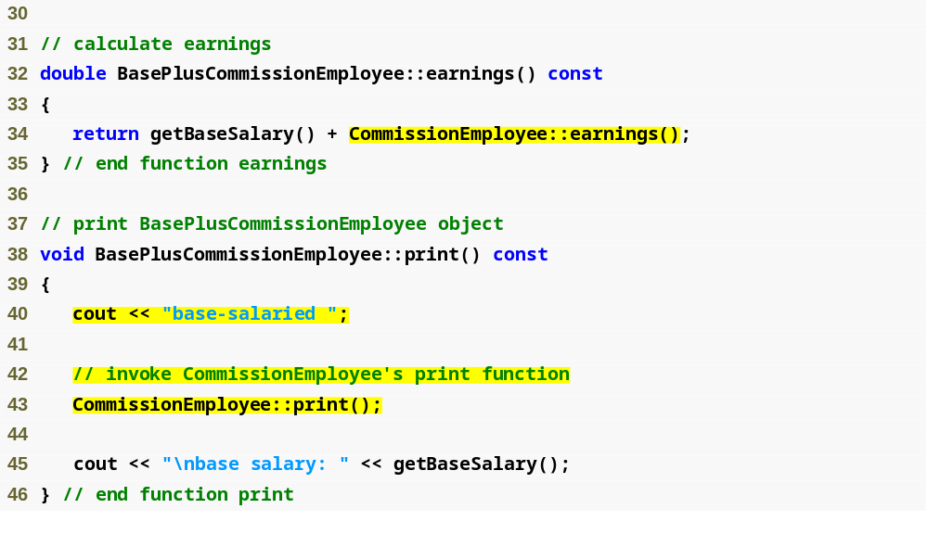
Outline
BasePlus
Commission
Employee.cpp
(2 of 2)
Invoke base class’s earnings function
Invoke base class’s print function

Slide 78
Common Programming Error 12.2
When a base-class member function is redefined in a derived class, the derived-class version often calls the base-class version to do additional work. Failure to use the :: operator prefixed with the name of the base class when referencing the base class’s member function causes infinite recursion, because the derived-class member function would then call itself.

Slide 79
Common Programming Error 12.3
Including a base-class member function with a different signature in the derived class hides the base-class version of the function. Attempts to call the base-class version through the public interface of a derived-class object result in compilation errors.

Slide 80
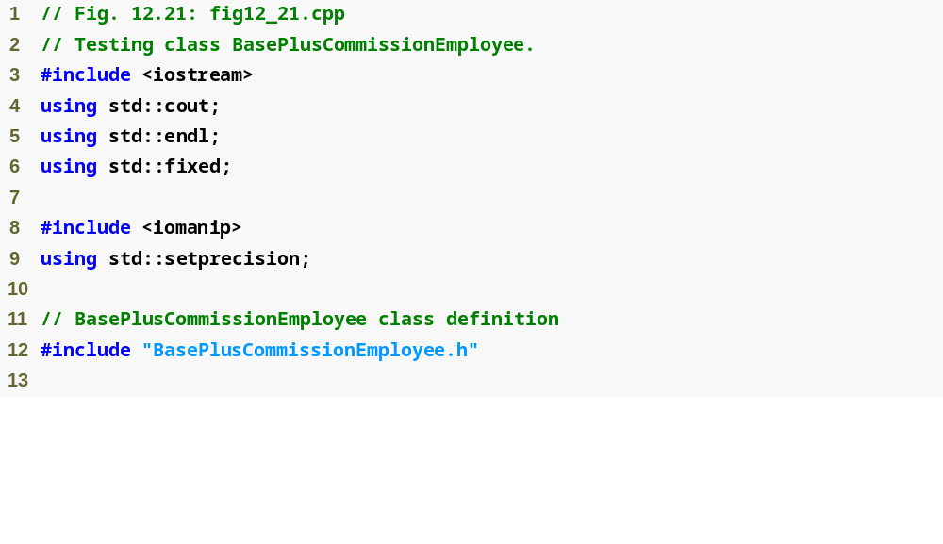
Outline
fig12_21.cpp
(1 of 3)

Slide 81
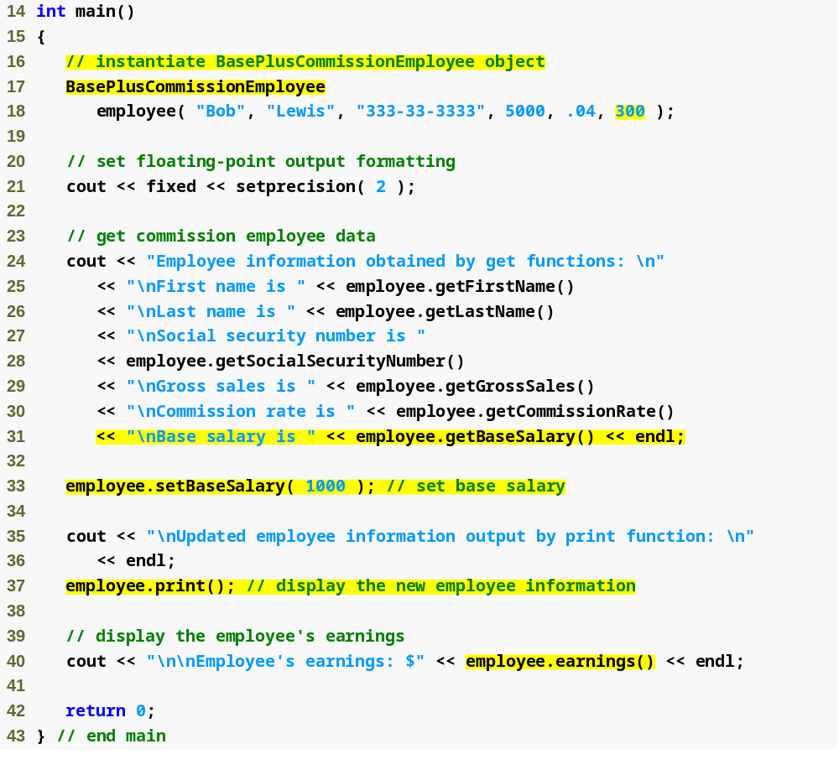
Outline
fig12_21.cpp
(2 of 3)
Create BasePlusCommissionEmployee object
Use inherited get methods to access base class private members
Use BasePlusCommissionEmployee get method to access private member
Use BasePlusCommissionEmployee set method to modify private data member baseSalary

Slide 82
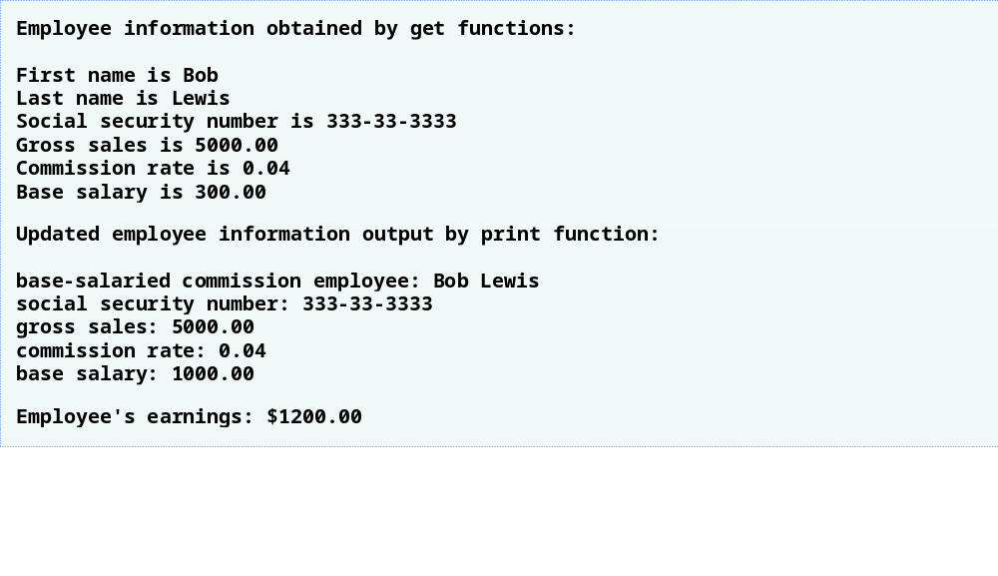
Outline
fig12_21.cpp
(3 of 3)

Slide 83
12.5 Constructors and Destructors in Derived Classes
Instantiating derived-class object
  Chain of constructor calls
    Derived-class constructor invokes base class constructor
      Implicitly or explicitly
    Base of inheritance hierarchy
      Last constructor called in chain
      First constructor body to finish executing
      Example: CommissionEmployee/BasePlusCommissionEmployee hierarchy
        CommissionEmployee constructor called last
        CommissionEmployee constructor body finishes execution first
    Initializing data members
      Each base-class constructor initializes its data members that are inherited by derived class

Slide 84
Software Engineering Observation 12.7
When a program creates a derived-class object, the derived-class constructor immediately calls the base-class constructor, the base-class constructor’s body executes, then the derived class’s member initializers execute and finally the derived-class constructor’s body executes. This process cascades up the hierarchy if the hierarchy contains more than two levels.

Slide 85
12.5 Constructors and Destructors in Derived Classes (Cont.)
Destroying derived-class object
  Chain of destructor calls
    Reverse order of constructor chain
    Destructor of derived-class called first
    Destructor of next base class up hierarchy next
      Continue up hierarchy until final base reached
        After final base-class destructor, object removed from memory
Base-class constructors, destructors, assignment operators
  Not inherited by derived classes

Slide 86
Software Engineering Observation 12.8
Suppose that we create an object of a derived class where both the base class and the derived class contain objects of other classes. When an object of that derived class is created, first the constructors for the base class’s member objects execute, then the base-class constructor executes, then the constructors for the derived class’s member objects execute, then the derived class’s constructor executes. Destructors for derived-class objects are called in the reverse of the order in which their corresponding constructors are called.

Slide 87
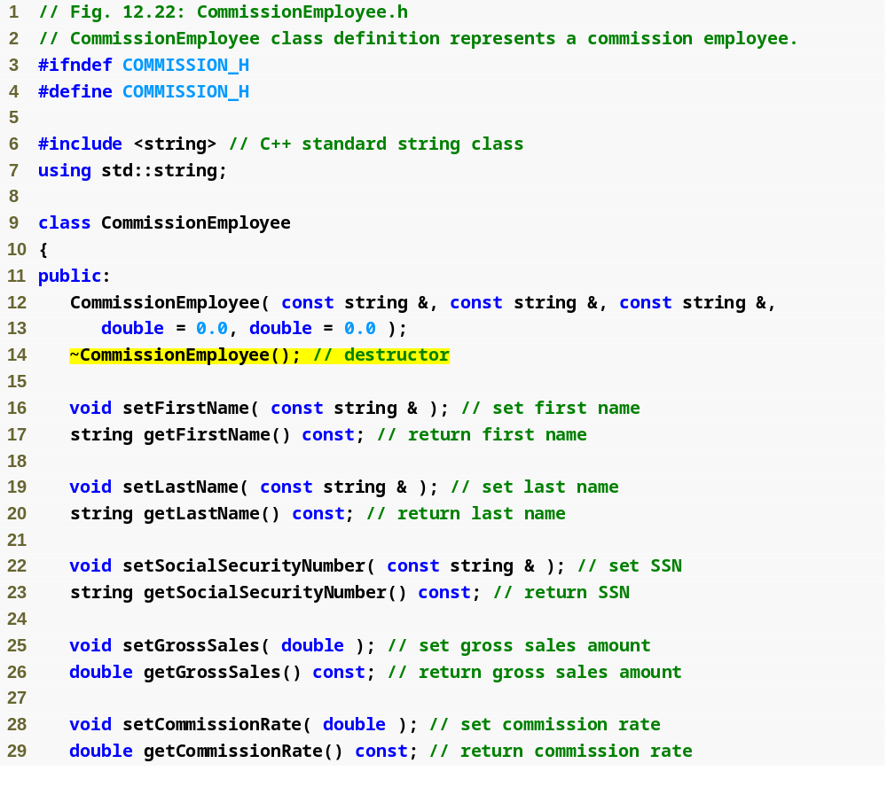
Outline
Commission
Employee.h
(1 of 2)
CommissionEmployee destructor

Slide 88
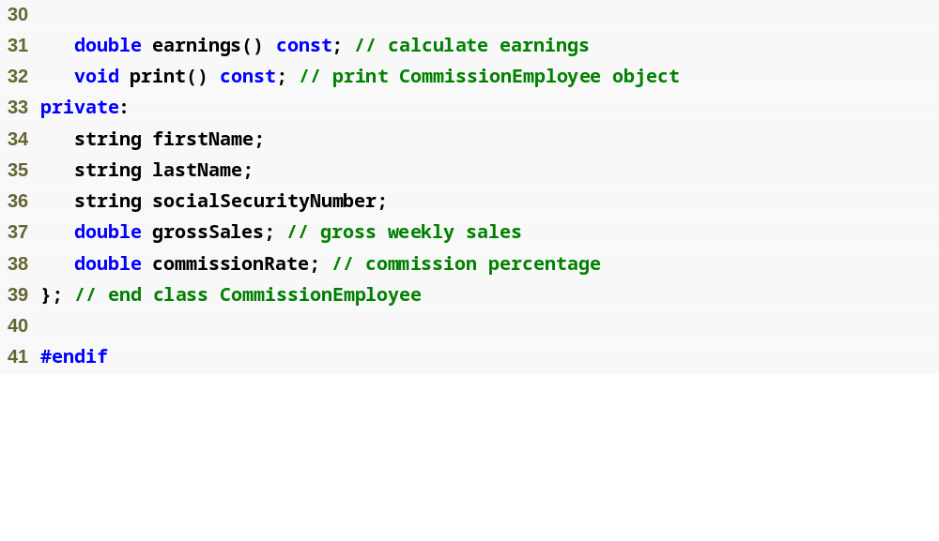
Outline
Commission
Employee.h
(2 of 2)

Slide 89
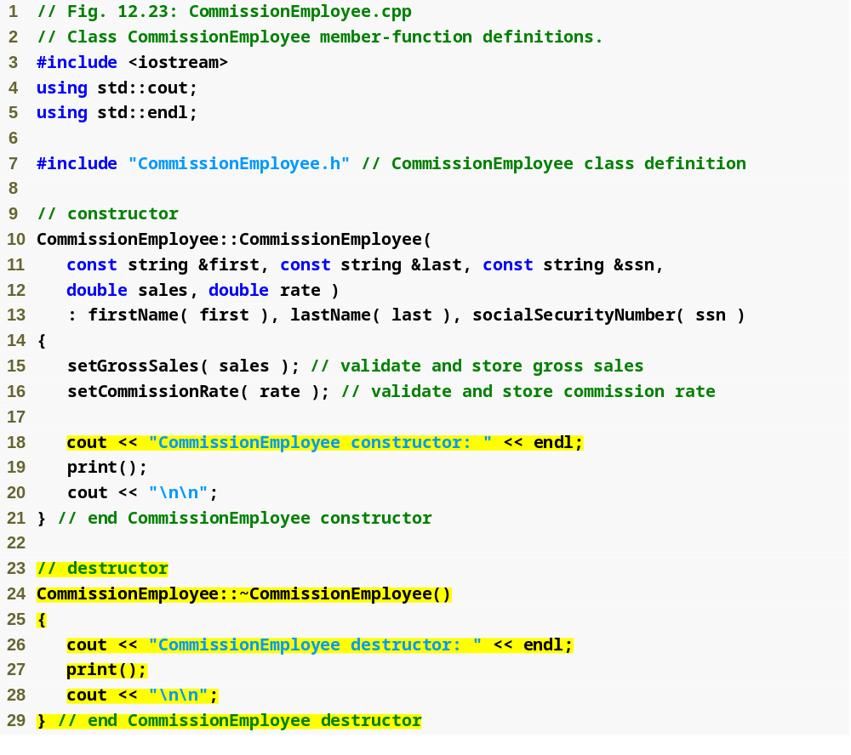
Outline
Commission
Employee.cpp
(1 of 4)
Constructor and destructor output messages to demonstrate function call order

Slide 90
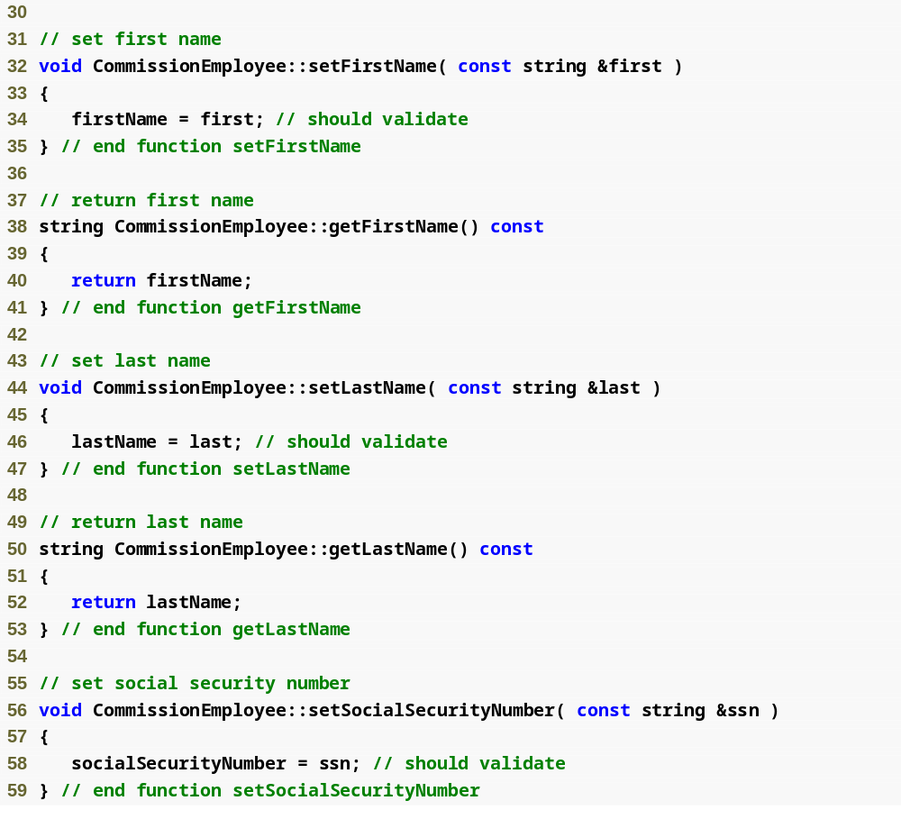
Outline
Commission
Employee.cpp
(2 of 4)

Slide 91
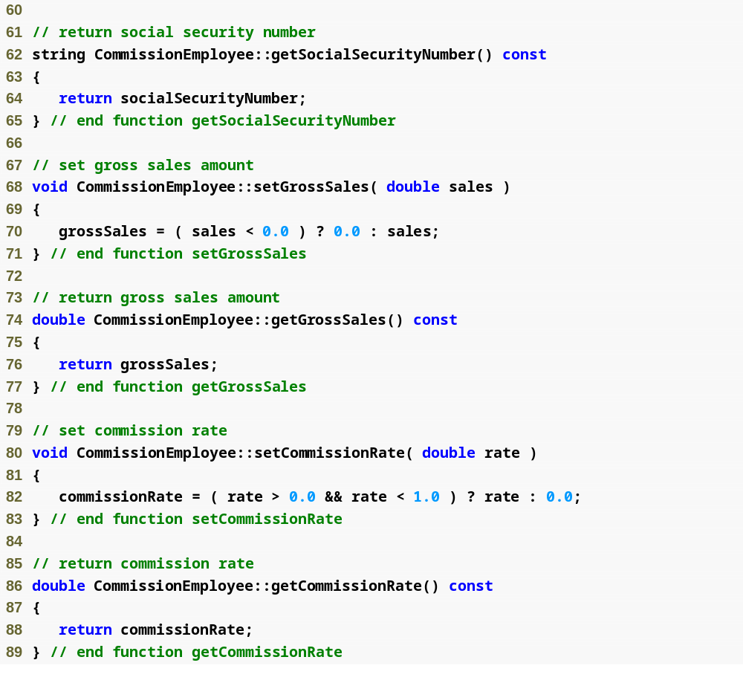
Outline
Commission
Employee.cpp
(3 of 4)

Slide 92
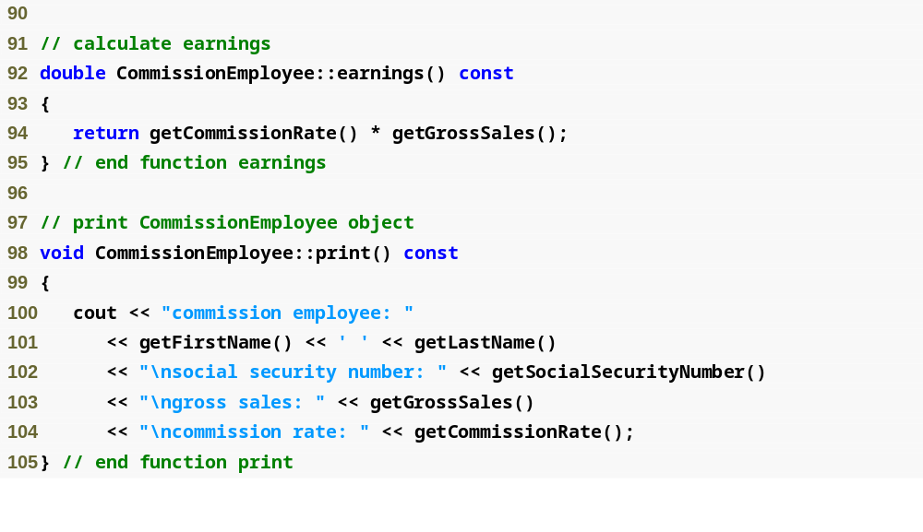
Outline
Commission
Employee.cpp
(4 of 4)

Slide 93

Outline
BasePlus
Commission
Employee.h
(1 of 1)
BasePlusCommissionEmployee destructor

Slide 94

Outline
BasePlus
Commission
Employee.cpp
(1 of 2)
Constructor and destructor output messages to demonstrate function call order

Slide 95

Outline
BasePlus
Commission
Employee.cpp
(2 of 2)

Slide 96

Outline
fig12_26.cpp
(1 of 4)

Slide 97

Outline
CommissionEmployee object goes in and out of scope immediately
fig12_26.cpp
(2 of 4)
Instantiate two BasePlusCommissionEmployee objects to demonstrate order of derived-class and base-class constructor/destructor function calls

Slide 98

Outline
fig12_26.cpp
(3 of 4)
CommissionEmployee constructor called for object in block; destructor called immediately as execution leaves scope
Base-class CommissionEmployee constructor executes first when instantiating derived-class BasePlusCommissionEmployee object
Derived-class BasePlusCommissionEmployee constructor body executes after base-class CommissionEmployee’s constructor finishes execution
Base-class CommissionEmployee constructor executes first when instantiating derived-class BasePlusCommissionEmployee object

Slide 99

Outline
Derived-class BasePlusCommissionEmployee constructor body executes after base-class CommissionEmployee’s constructor finishes execution
fig12_26.cpp
(4 of 4)
Destructors for BasePlusCommissionEmployee object called in reverse order of constructors
Destructors for BasePlusCommissionEmployee object called in reverse order of constructors

Slide 100
12.6 public, protected and private Inheritance
public inheritance
  Base class public members → derived class public members
  Base class protected members → derived class protected members
  Base class private members are not accessible
protected inheritance (not is-a relationship)
  Base class public and protected members → derived class protected members
private inheritance (not is-a relationship)
  Base class public and protected members → derived class private members

Slide 101

Fig. 12.27 | Summary of base-class member accessibility in a derived class.

Slide 102
12.7 Software Engineering with Inheritance
Customizing existing software
  Inheriting from existing classes
    Can include additional members
    Can redefine base-class members
    No direct access to base class’s source code
      Only links to object code
  Independent software vendors (ISVs)
    Develop proprietary code for sale/license
      Available in object-code format
    Users derive new classes
      Without accessing ISV proprietary source code

Slide 103
Software Engineering Observation 12.9
At the design stage in an object-oriented system, the designer often determines that certain classes are closely related. The designer should “factor out” common attributes and behaviors and place these in a base class, then use inheritance to form derived classes, endowing them with capabilities beyond those inherited from the base class.

Slide 104
Software Engineering Observation 12.10
The creation of a derived class does not affect its base class’s source code. Inheritance preserves the integrity of a base class.

Slide 105
Software Engineering Observation 12.11
Just as designers of non-object-oriented systems should avoid proliferation of functions, designers of object-oriented systems should avoid proliferation of classes. Proliferation of classes creates management problems and can hinder software reusability, because it becomes difficult for a client to locate the most appropriate class of a huge class library. The alternative is to create fewer classes that provide more substantial functionality, but such classes might provide too much functionality.

Slide 106
Performance Tip 12.3
If classes produced through inheritance are larger than they need to be (i.e., contain too much functionality), memory and processing resources might be wasted. Inherit from the class whose functionality is “closest” to what is needed.

